Slide 1


CAPSTONE PROJECT
MOVIE COMMERCE
Presented By:
1. A.Surya prakash -Solamalai College of Engineering-Mechanical Engineering

Slide 2
OUTLINE
○
Probelm Statement
Proposed Solution
System Approach
Algorithm & Deployment
Result
Conclusion
Future Scope
References
○ ○ ○ ○
○
○ ○

Slide 3
PROBLEM STATEMENT
"In an increasingly digital and interconnected world, the landscape of movie commerce faces challenges in maximizing revenue streams while ensuring fair compensation for creators. This encompasses issues such as optimizing distribution channels, combating piracy, leveraging emerging technologies for monetization, and balancing the interests of various stakeholders, including filmmakers, distributors, exhibitors, and streaming platforms. The challenge lies in developing innovative strategies and business models that sustainably support the creation, distribution, and consumption of diverse and high-quality cinematic content in a rapidly evolving marketplace."

Slide 4
PROPOSED SOLUTION
To address the complexities of movie commerce, a multifaceted approach is needed. This includes implementing robust anti-piracy measures through technological solutions and legal frameworks to protect intellectual property rights. Additionally, fostering collaboration between stakeholders to streamline distribution processes and ensure fair compensation for all parties involved. Embracing emerging technologies like blockchain for transparent royalty tracking and smart contracts can enhance trust and accountability in revenue sharing. Furthermore, exploring innovative monetization models such as subscription-based services, pay-per-view, and merchandise tie-ins can diversify revenue streams and adapt to changing consumer preferences. Ultimately, a balance between protecting creators' rights and embracing technological advancements is crucial for the sustainable growth of the movie commerce industry."

Slide 5
SYSTEM APPROACH
1.*Understanding Stakeholders**: Identify key players like filmmakers, distributors, and audiences, and their roles.
2. **Analyzing Market Trends**: Study audience preferences, technology impact, and distribution channels. 3. **Optimizing Content Creation**: Focus on producing high-quality content with broad app
4.**Leveraging Distribution Channels**: Utilize various platforms like theaters, streaming services, and international markets. 5.**Monetization Strategies**: Implement revenue models such as subscriptions, advertising, and merchandise. 6. **Combatting Piracy**: Employ measures to protect content and enforce intellectual property rights. 7.**Utilizing Data Insights**: Use analytics to make informed decisions about content and marketing strategies.

Slide 6
ALGORITHM & DEPLOYMENT
1. **Acquire Content**: Secure movies for distribution. 2. **Build Platform**: Develop a website or app for users to access movies. 3. **Add Payment Options**: Integrate payment methods for users to purchase or rent movies. 4. **Market Platform**: Advertise the platform to attract users. 5. **Analyze Data**: Collect user data to understand preferences and improve offerings. 6. **Provide Support**: Offer customer service for user inquiries and issues. 7. **Update Regularly**: Continuously improve the platform based on feedback and trends.

Slide 7
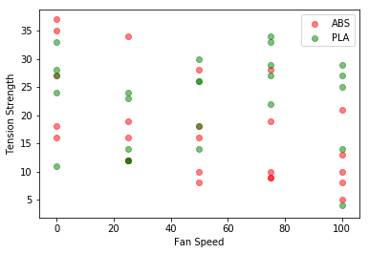
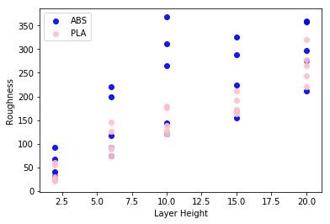
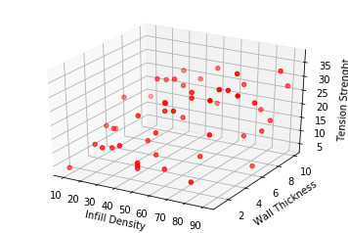
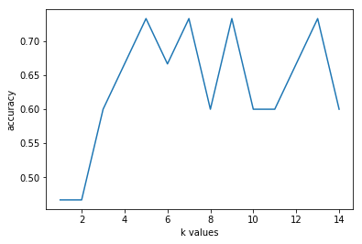
RESULT

Slide 8
CONCLUSION
In conclusion, developing a successful movie commerce platform requires a systematic approach that encompasses content acquisition, platform development, monetization strategies, user engagement, and ongoing improvement. By understanding the needs of stakeholders, leveraging technology effectively, and staying responsive to market dynamics, movie commerce endeavors can thrive in a competitive landscape, providing value to both content creators and audiences alike.

Slide 9
FUTURE SCOPE
the future of movie commerce looks bright, with opportunities for growth driven by emerging technologies, global expansion, interactive content, localization efforts, and data-driven insights.

Slide 10
REFERENCES
https://www.kaggle.com/datasets/afumetto/3dprinter

Slide 11
THANK YOU

